Slide 1
Improving Reproducibility Through Better Software Practices
Anshu Dubey
Argonne National Laboratory
Open-Source Software for Fusion Energy (OSSFE) Conference
Contributors: David E. Bernholdt (ORNL), Jared O’Neal (ANL), Patricia A. Grubel (LANL), Michael A. Heroux (SNL), David M. Rogers (ORNL), Gregory R. Watson (ORNL)
Notes:
Originally a 45 minute talk, cut to about 30 by putting the Data Management Plans and Reproducibility after the summary and cutting the Psychology example and the 2 slides at the end, probably covered under testing.
To make this a 15 minute talk go through the initial examples and incentives quickly then cover the How to sections.

Slide 2
License, Citation and Acknowledgements
License and Citation
This work is licensed under a Creative Commons Attribution 4.0 International License (CC BY 4.0).
The requested citation for the tutorial is: Anshu Dubey,
Acknowledgements
This work was supported by the U.S. Department of Energy Office of Science, Office of Advanced Scientific Computing Research (ASCR), and by the Exascale Computing Project (17-SC-20-SC), a collaborative effort of the U.S. Department of Energy Office of Science and the National Nuclear Security Administration.
This work was supported by the U.S. Department of Energy, Office of Science, Office of Advanced Scientific Computing Research, Next-Generation Scientific Software Technologies (NGSST) program.
This work was performed in part at the Argonne National Laboratory, which is managed by UChicago Argonne, LLC for the U.S. Department of Energy under Contract No. DE-AC02-06CH11357.
This work was performed in part at the Los Alamos National Laboratory, which is managed by Triad National Security, LLC for the U.S. Department of Energy under Contract No.89233218CNA000001
This work was performed in part at the Oak Ridge National Laboratory, which is managed by UT-Battelle, LLC for the U.S. Department of Energy under Contract No. DE-AC05-00OR22725.
This work was performed in part at Sandia National Laboratories. Sandia National Laboratories is a multi-mission laboratory managed and operated by National Technology and Engineering Solutions of Sandia, LLC., a wholly owned subsidiary of Honeywell International, Inc., for the U.S. Department of Energy’s National Nuclear Security Administration under contract DE-NA0003525.

Slide 3
Terminology
A few of the terms used when talking about this topic…
Reproducibility
Replicability
Reliability
Correctness
Accuracy
Transparency
Credibility
They don’t mean exactly the same thing…
…but for the purposes of this presentation, the differences don’t really matter

Slide 4

Reproducible vs Replicable: A Special Note
Historically different communities have defined these two differently
With the increased focus, there has also been an effort to unify the language
Consensus around the definitions of Claerbout, et al.
Others are in the process of switching their terminology to match, i.e., ACM
Reproducible: Another team is able to obtain the same result using the authors’ experimental environment
Replicable: Another team is able to obtain consistent results using a different experimental environment
doi:10.2172/1481626
doi:10.17226/25303

Slide 5

Why Reproducibility is Important
Notes:
Examples that resulted in disputed results
Additional Incentives
Ensure goals include credible science through better software
Limited resources
Data requirement plans for research
Reproducibility and transparency initiatives for publications

Slide 6
Example
Behavior of pure water just above homogeneous nucleation temperature (~ - 40 C/F).
Debenedetti/Princeton (2009):
2 possible phases: High or low density.
Chandler/Berkeley (2011):
Only 1 phase: High density.
No sharing of details across teams until 2016:
Chandler in Nature: “LAMMPS codes used in refs 5 and 12 are standard and documented, with scripts freely available upon request.”
Debenedetti with colleague Palmer: ”Send us your code.”
Received code after requests and appeal to Nature.
doi:10.1063/PT.6.1.20180822a

Slide 7
Example
Palmer located bug/feature in Berkeley code.
Used to speed up LAMMPS execution.
Replaced with more standard approach.
Obtained result similar to Debenedetti 2009.
Resolution took 7 years.
For Palmer, the ordeal exemplifies the importance of transparency in scientific research, an issue that has recently drawn heightened attention in the science community. “One of the real travesties,” he says, is that “there’s no way you could have reproduced [the Berkeley team’s] algorithm—the way they had implemented their code—from reading their paper.” Presumably, he adds, “if this had been disclosed, this saga might not have gone on for seven years.”
doi:10.1063/PT.6.1.20180822a

Slide 8
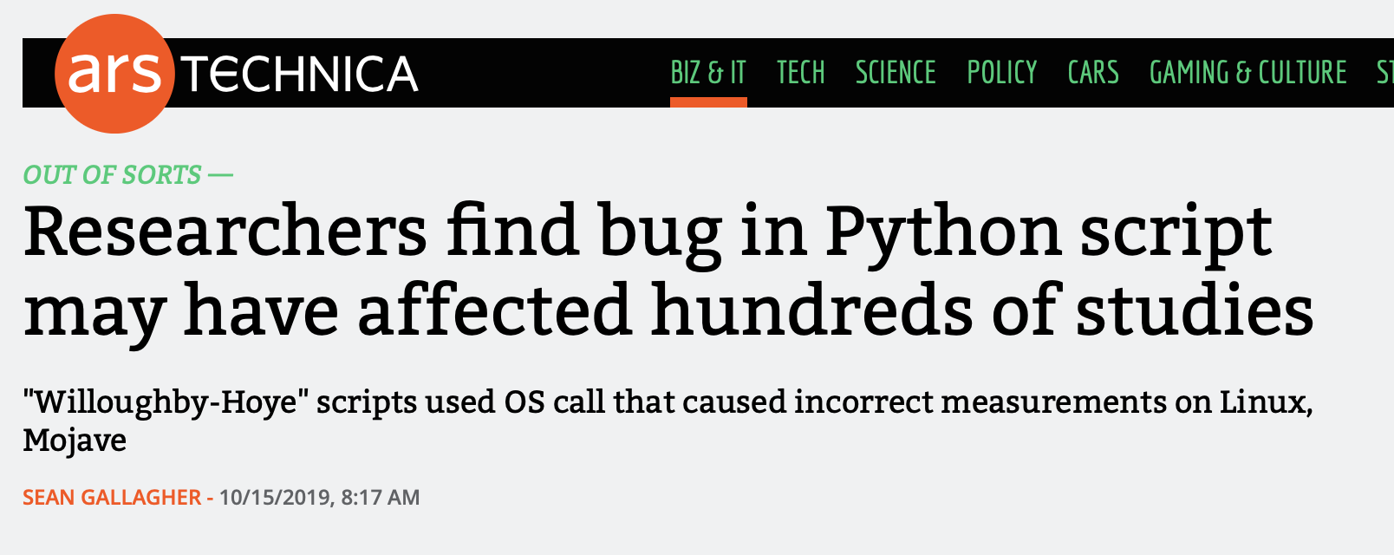
A Recent Example: Python Behaves Differently on Different Platforms
Scripts for analyzing experimental nuclear magnetic resonance (NMR) data
Scripts use Python's glob module (listing filenames matching a pattern)
Module ordered results differently in Linux and Mac Mojave
Results depended on the order in which files were processed
Casts doubt on results in 150 papers
Would a unit test have caught this?
https://arstechnica.com/information-technology/2019/10/chemists-discover-cross-platform-python-scripts-not-so-cross-platform/

Slide 9
Science through computing is, at best, as credible as the software that produces it!

Slide 10
Incentives for Paying Attention to Reproducibility
Common statement: “I would love to do a better job on my software, but I need to:
Get this paper submitted
Complete this project task
Do something my employer values more
Goal: Change incentives to include valuing of better software, better science
This is a long-term goal, requiring a culture change in (computational) science which is in the early stages

Slide 11
Funders and the Community Setting Expectations for Your Data
Data Management Plans
FAIR Data Principles (gofair.us)
Most research sponsors require data management plans as part of proposals
Example: NSF policy on Dissemination and Sharing of Research Results
Promptly publish with appropriate authorship
Share data, samples, physical collections, and supporting materials with others, within a reasonable time frame
Share software and inventions
Investigators can keep their legal rights over their intellectual property, but they still have to make their results, data, and collections available to others
Policies will be implemented via
Proposal review
Award negotiations and conditions
Support/incentives
Address data producers and publishers to promote maximum use of research data
Findability
Data and supplementary materials have sufficiently rich metadata and a unique and persistent identifier.
Accessibility
Metadata and data are understandable to humans and machines. Data is deposited in a trusted repository.
Interoperability
Metadata use a formal, accessible, shared, and broadly applicable language for knowledge representation.
Reusability
Data and collections have a clear usage licenses and provide accurate information on provenance.

Slide 12
Supercomputing (SC) Conference Reproducibility Initiative
Create tangible progress towards scientific rigor by enhancing the reproducibility of accepted papers
The Artifact Description (AD) Appendix will be auto-generated from author responses
Greater emphasis on linking to the broader products resulting from research
An indication that no artifacts were created or used might also be acceptable
For accepted papers, the availability and functionality of automated Artifact Evaluation (AE) will be evaluated and rewarded
Easily reproduce a paper’s key results and claims with provided artifacts
Accepted papers with available artifacts will be honored with the appropriate ACM badges.
Collaborating with Chameleon Cloud, CloudLab, Jetstream via XSEDE, SDSC, and TACC for infrastructure needs
Webinars will be provided for authors interested in using these resources

Slide 13
SC AD/AE Appendices Process & Badges
Artifact Description/Artifact Evaluation (AD/AE) process is single-blind
The terms artifact and research object are synonymous
Software, datasets, environment configuration, mechanized proofs, benchmarks, test suites with scripts, etc.
A complete artifact package must contain (1) the computational artifacts, and (2) instructions/documentation describing the contents and how to use it
The goal of Artifact Description is to provide the evidence needed for greater scientific rigor and transparency of the scientific conclusions of the manuscript
Mandatory for paper submissions (since SC19)
The goal of Artifact Evaluation is to award badges to artifacts of accepted papers
An optional step

Slide 14
Increasing Attention on Reproducibility from Publishers
More publication venues are adding reproducibility recognition or requirements
ACM Replicated Reproducible Computational Results (RCR)
ACM TOMS, TOMACS
http://toms.acm.org/replicated-computational-results.cfm
ACM Badging
Functional, reusable, available, replicated, reproduced
https://www.acm.org/publications/policies/artifact-review-and-badging-current
These conferences have artifact evaluation appendices:
CGO, PPoPP, PACT, RTSS and SC
http://fursin.net/reproducibility.html
NISO Committee on Reproducibility and Badging
https://www.niso.org/niso-io/2019/01/new-niso-project-badging-scheme-reproducibility-computational-and-computing
Publishers: ACM, IEEE, figshare, STM, Reed Elsevier, Springer Nature

Slide 15
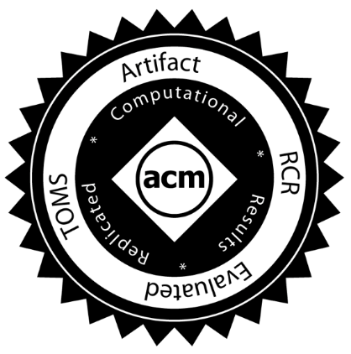
ACM TOMS Reproducible Computational Results (RCR)
Submission: Optional RCR option
Standard reviewer assignment: Nothing changes
RCR reviewer assignment:
Concurrent with standard reviews
As early as possible in review process
Known to and works with authors during the RCR process
RCR process:
Multi-faceted approach, Bottom line: Trust the reviewer
Publication:
Reproducible Computational Results Designation
The RCR referee acknowledged
Review report appears with published manuscript
Incentives:
Journal: raises the credibility/quality/rigor of papers it publishes
Authors: badging indicates additional credibility/quality/rigor of paper
Reviewer: companion publication

Slide 16
Strategies for Improving Reproducibility During Development
Solid versioning practices are fundamental to reproducibility
Version control of code, documentation, and other artifacts
Frequent commits (perhaps to a separate development branch)
Provide versioning information in key output(s)
Version numbers (i.e., semantic versioning) are useful, but when do you increment them?
Automatic identifiers (i.e., git commit hash) are less ambiguous, but may not be as meaningful
Is the code you’re building modified from the version in the repository? (Not often done in practice)
Maintaining documentation (and other artifacts) in sync with code
You’ll forget
Or you won’t have (make) time to go back to it

Slide 17
Strategies for Improving Reproducibility During Development
Build in quality from the start
Define and follow coding standards
Not just code style
Expectations for kinds and extent of documentation, types and rigor of tests
Develop tests as you code
Write tests while the code is fresh in your mind
Test Driven Development (TDD) means write tests before code, then code to pass the tests
Require increasingly rigorous testing as the code becomes more “public”
Testing has costs, need to balance level of risk against cost of creating and executing tests
Also think about frequency of tests at different levels of cost (c.f. continuous integration)
Practice peer code review
Per commit – should meet standards, and be understood and judged correct by reviewer
Pair experienced reviewers with less experienced coders to help ensure quality
Retrospective if you have a lot of existing unreviewed code

Slide 18
Strategies for Improving Reproducibility During Development
Understand the numerics of your code
Floating point numbers are just approximations to real numbers
Many numerical methods have “quirks” too
If you’re using reduced- or mixed-precision computations, carefully compare with full-precision versions
On paper during development of the algorithms
Maybe provide an alternative full-precision computational path
Consider the possible effects of non-determinism due to concurrency
Floating point calculations done in different order may yield different results
Maybe useful to have an option to force deterministic computation
Look for testing/verification methods that don’t depend on bitwise reproducibility
Know your error bounds and develop tests against them
E.g., conservation rules apply to many physical quantities
Consider consulting subject matter experts for help

Slide 19
Strategies for Improving Reproducibility After Development
Testing, testing, and more testing!
Add “regression tests”
If you fix a bug, add a test to make sure that bug doesn’t creep back in
Add more tests
Be creative
Think about common cases, then corner cases
Think about misuse (unintentional or intentional)
Think about synthetic tests with synthetic data
Think about low-cost tests that can be “always on” (even if they’re not so stringent)
Can you detect silent data corruption?
Test your third-party dependencies
Are your tools doing what you think they’re doing?
What if you’re using a new version?
How do you decide if it is okay to upgrade to a new version?
Test your tests!
Make sure tests fail when they’re supposed to!
Thoroughly verify the code
Does the code do what you intended it to do?
On all relevant platforms (compilers, hardware, etc.)
Test regularly
To identify and document where changes to the underlying platform change code behavior/results

Slide 20
Digression – “Physics” (or Math)-Based Testing Strategies
Use what you know (or can construct) about the model you’re studying to test its implementation
Synthetic operators with known properties
Spectrum (huge diagonals)
Rank (by construction)
Invariance principles
Translational, rotational, etc.
Physical symmetries
Mathematical symmetries
Conservation rules
Fluxes, energy, mass, etc.
…

Slide 21
Digression – Design by Contract Programming
Building testing into your routines
To complement, not replace, other testing
The interface to a routine can be thought of as a contract between caller and the callee (the routine)
What does the routine expect on input? preconditions
What does the routine guarantee at completion? postconditions
What does the routine leave unchanged? invariants
Given valid inputs (preconditions satisfied) a routine should guarantee valid outputs (postconditions satisfied, invariants maintained)
If the preconditions are not satisfied, the routine should return an error
Emphasize low-costs tests that can be always-on
May need to be able to switch enforcement of expensive tests on/off (but try not to!)
Making the contract explicit facilitates correct use of routines
Especially when routine is reused in another context
Especially by those not intimately familiar with them

Slide 22
Strategies for Improving Reproducibility in Computational Experiments
Running simulations for science discovery is more of a craft and less of science. More than any other aspect of computational science it relies on experience and acquired wisdom that helps one develop a nose for fruitful possibilities.

Slide 23


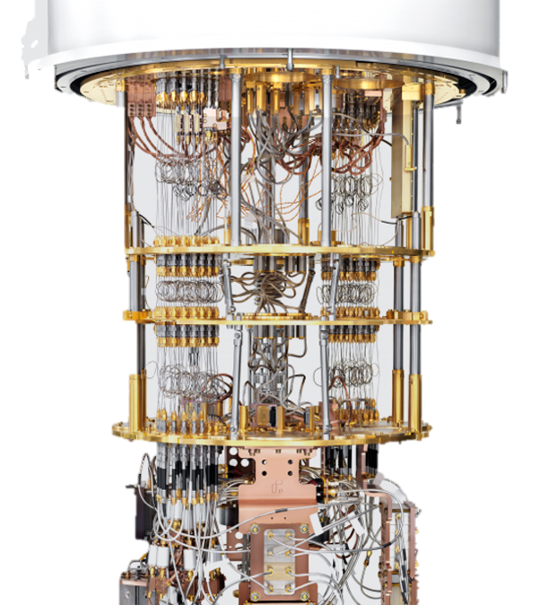
Why do you need to plan?
Machines are expensive and rare resources
Operating them is also very expensive
If you made a mistake in your input parameters and got garbage results on a large scale run, you just wasted hundreds of thousands of dollars
Many people are competing for these resources
Your wasted run is likely to be either your or someone else’s opportunity lost
You are likely charting new scientific territory
Some aspect of using your code may not have been important before, but may become critical in the new study
Some solver may run up against the limits of its validity
Inflight correction may be needed to parameters to continue with the study
Aim for no surprises, but be prepared for them

Slide 24
Strategies for Improving Reproducibility During Planning
Develop hierarchy of analysis
Full analysis of runs is not feasible in flight
Intermediate level analysis can give further insight into health of the simulation
Perform pilot/test runs to build confidence in correctness, performance, scaling
Often useful to pursue an incremental/layered strategy
Ensure that you have the resources to store and/or analyze the outputs
What can you afford to archive?
What will you need to process and delete?
What will you need to process during execution or stream?
Plan your experiments thoroughly
If you’re in a team, designate one person to coordinate the experimental campaign
Know what you need (in the code, as inputs, as outputs to capture/analyze, etc.)
Know what to expect (in results, performance/cost, etc.)
How will you convince yourself that your results are trustworthy?
Develop helpful diagnostics
Low overhead ways of confirming the health of the run
Are conserved quantities conserved?
Has any quantity become unphysical?

Slide 25
Story of one simulation campaign
Theory of Type Ia supernova explosion – 2006/2007
Evidence from observations:
Light curve powered by Ni56 decay
Evidence of medium weight elements, but in much smaller quantities
Implied transition from deflagration to detonation
A 2D exploratory run had given a tantalizing answer to how?
To confirm a full 3D run was needed at good enough resolution
It would be the largest run of its kind at the time – totally uncharted territory
Until then 3D runs had been octants relying on symmetry
The 2D run had shown that symmetry had to be avoided

Slide 26
Preparation Steps
Step 1 – develop a test that represents the most complex physics interactions
Challenges:
Features take a long time to develop
Want to ensure that at least one refinement step occurs during the test
IO too slow to restart from a large checkpoint at late stage of the run
Also test would need a large chunk of the machine
Use physics understanding to create initial conditions that would quickly develop comparable complexity

Slide 27
Preparation Steps
Step 2 – Use the new test to characterize the performance behavior of the target platform
Motivation:
Standard performance studies could not give crucial information
AMR refinement patterns make each application different
Interoperability and trade-off opportunities needed to explored in a closely resembling simulation behavior
Full fidelity 2D runs, and a set of runs of the new test provided enough information to extrapolate and estimate needed CPU hours

Slide 28
Preparation Steps
Step 3 – Look for trade-offs and optimization opportunities
Motivation:
Initial CPU estimates too high to complete the runs within allocations
Exploration of any parameter space needs to minimize individual run times
Many opportunities were found, documented in reference below.
Identify redundant refinement and get rid of it
Coarsen computations for some physics
Move some computations to post-processing
All optimizations were based on scientific and numerical intuitions
Dubey A, Calder AC, Daley C, et al. Pragmatic optimizations for better scientific utilization of large supercomputers. The International Journal of High Performance Computing Applications. 2013;27(3):360-373. doi:10.1177/1094342012464404

Slide 29
Preparation Steps
Step 4 – Prepare diagnostics and quick analysis mechanism
Examples-- diagnostics
Conservation of mass, momentum energy
Changes in dt recorded in the logfiles
Spikes in variable values
Examples – quick analysis
Quick visualization of random 2D slices
Inspection of critical quantities in 1D

Slide 30
Preparation Steps
Step 4 – Prepare diagnostics and quick analysis mechanism
Examples-- diagnostics
Conservation of mass, momentum energy
Changes in dt recorded in the logfiles
Spikes in variable values
Examples – quick analysis
Quick visualization of random 2D slices
Inspection of critical quantities in 1D

Slide 31
Outcome
A successful campaign
But not without hitches
Optimization related runs were not given the same level of care
Data was considered disposable
Code changes were documented

Slide 32
Outcome
A successful campaign
But not without hitches
Optimization related runs were not given the same level of care
Data was considered disposable
Code changes were documented
For the paper the referee asked for details from optimizations
We did not have them
Fortunately the referee was satisfied with reasoning and other supporting evidence we produced

Slide 33
Strategies for Improving Reproducibility During Experiments
Can you reproduce the code used for each and every experiment?
Three years later?
Use only well-defined versions of code (i.e., official “releases”, tags, etc.)
Main or development branches are often moving targets
Capture the exact version of the code used for each experiment
Is the code you’re building exactly what’s in the version control repo?
Don’t change versions during a related series of experiments (unless you have to)
If you have to change versions, know exactly what changed
Capture the exact version of the code used for each experiment
Use only versions of code that have been thoroughly verified
Continue to use regular testing to identify changes due to the underlying platform
E.g., compiler release introduces a new optimization that changes numerical results

Slide 34
Strategies for Improving Reproducibility During Experiments
Can you reproduce the code used for each and every experiment?
Three years later?
Use only well-defined versions of code (i.e., official “releases”, tags, etc.)
Main or development branches are often moving targets
Capture the exact version of the code used for each experiment
Is the code you’re building exactly what’s in the version control repo?
Don’t change versions during a related series of experiments (unless you have to)
If you have to change versions, know exactly what changed
Capture the exact version of the code used for each experiment
Use only versions of code that have been thoroughly verified
Continue to use regular testing to identify changes due to the underlying platform
E.g., compiler release introduces a new optimization that changes numerical results
Take a leaf out of experimentalists playbook – use lab notebooks

Slide 35
Definition of a lab notebook
A goal of keeping a lab notebook is "...to write with enough detail and clarity that another scientist could pick up the notebook at some time in the future, repeat the work based on the written descriptions, and make the same observations that were originally recorded. If this guideline is followed, even the original author will be able to understand the notes when looking back on them after considerable time has passed!”
- Howard Kanare, Writing the Laboratory Notebook
Notes:
Module designed with the expectation that attendees have a basic idea of what a lab notebook is as well as some experience (e.g., in university lab classes).
This is just a moment to confirm this and understand the bare minimum of what a lab notebook should do. Put this up front so that people can relate slides to what they understand of lab notes.
Emphasize that this is mostly likely the base minimum. In this sense, the notebook is like a cookbook with a collection of recipes we want others to execute.

Slide 36
Data & Information
Data
Collection of numbers, symbols, text, etc.
It has value only because it was recorded and exists.
Example: Timeseries representation of temperature, relative humidity, and precipitation.
Information
Facts gleaned from data.
Answers questions such as who, what, when, how much, how long, etc.
Example: Starting at 2pm the temperature dropped by 5ºF over 15 minutes. At 2:05 pm it started to rain and 0.25” of rain was accumulated over the next 30 minutes.
Notes:
My understanding is that data is *not* facts, as some claim. Rather, data can be flawed and noisy. Information is facts that are true relative to the potentially flawed data.
Data is valuable because it helps us make decisions.
Information is data made (hopefully) useful.

Slide 37
Knowledge & Understanding
Knowledge
Derived from information, experience, and understanding.
Example: When relative humidity levels are high and the temperature drops substantially, there is an increased probability of precipitation.
Understanding
A deep theoretical background in and practical experience with the system whose data was acquired and studied?
The ability to explain why?
“Understanding is a kind of ecstasy” – Carl Sagan
Example: A meteorologist could explain at different levels of detail how the atmosphere works to substantiate the knowledge.
Notes:
Knowledge is generated by a process in such a way that it is an educated best guess. But, it should be a solid and justifiable educated guess. In this sense, it is not true but our best current guess at what is true.
I didn’t use the given timeseries information to derive this knowledge. Someone with understanding of meteorology did. They have a deep understanding derived from years of study and experience. However, that person presented and communicated the knowledge for consumption by those without understanding.
If a person doesn’t have understanding they can speculate at what the knowledge should be. Hopefully having understanding can elevate the statement from speculation to knowledge because understanding can substantiate at a level required by other experts.
It’s hard to define understanding. I have just written down my best guesses.
When you go to school, are your teachers and professors putting understanding in your head or do they share knowledge and create an environment in which one can generate understanding?
Understanding is built on the shoulders of giants. You read an article that helps you generate understanding. But the author of that article generated it from understanding he or she developed from taking classes with other

Slide 38
Knowledge Management
DIKUW is related to knowledge management
We want to
Recognize when we generate knowledge
Capture and preserve that knowledge
Communicate that knowledge
Scientific work can benefit from knowledge management
Is knowledge communication only about communicating to others?
Notes:
Really most any project benefits from putting some thought into knowledge management.
The key is first to recognize when knowledge is generated. Once I became aware of this classification and began to think in terms of it, it became easier for me to recognize knowledge generation. It’s as if a bell goes off in my brain that indicates we need to record what was just said.
The answer to the question is ”clearly no”, We need to communicate to our future selves for the sake of productivity and reproducible research. Refer back to minimal definition of lab notebooks.

Slide 39
Example: Lessons learned
After we live through an experience, we want to derive lessons learned
Experience is valuable, more so if we reflect and are thoughtful
Generate/capture knowledge to grow, improve, and avoid difficulties/mistakes
Hope to improve understanding
We get more if we derive lessons learned together
Create more or higher quality knowledge
Communicate the knowledge implicitly
Should we communicate lessons learned to others?
Notes:
The point of this slide is to map the high-level, abstract concepts (which some might not like) onto a concrete example that we know & understand.
I believe that this is also known as debriefing.

Slide 40
Which leads us to documentation
Documentation is knowledge communication & can build understanding
Data at the bottom. Knowledge as we move up?
Some documents frozen at creation. Others are living.
Does this capture how hard it is to do documentation in a distributed, digital world?
Notes:
Documentation is capture, preserve, & communicate
Not all documents are alike.

Slide 41
And finally, we reach our destination
Lab notebooks are
A fundamental part of communication as well as rigorous, reproducible science in a lab,
A common-place or required part of an experimental laboratory,
Populating a scientific “lab notebook” is increasingly an “automated” process in many modern experimental and observational research environments,
A tool for preventing scientific fraud, and
Record of invention and defending against allegations of fraud.
Lab notebooks
Should be used regularly,
Should be comprehensive and never filtered,
Don’t need perfect grammar and full sentences,
Content is frozen at creation, and
Hopefully contains more than just data (e.g., motivation, reasoning, conclusions).
They aren’t good at communicating knowledge, but
people interact, evolve, and grow by collaborating through the notebook.
Notes:
Automated is in quotes because the TIOs and astronomers still needed to input information into a system. But there was a process for them to input such data into tools that aggregated their input with other notes.
Relate back to minimal lab notebook definition. We want more that just a cookbook.
Notebooks serve as implicit communication

Slide 42
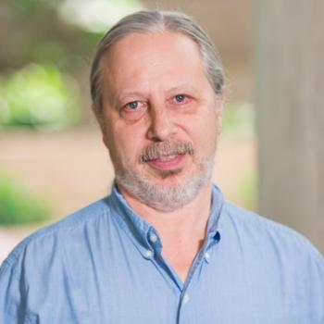
Conversations with Carlo
Carlo Graziani is a Computational Scientist at ANL
BSSw blog article HPC and the Lab Manager
As researchers’ careers progress
The problems become more complex and larger
Previous informal techniques for executing a study start to fail
The researchers' sense that something is missing
“Doing in-flight airplane repair”
They invent processes and tools to compensate
This happened to Carlo and at some point, he realized that
“I had re-invented the lab notebook!”

Slide 43
No one likes writing lab notes
“Lab notes are a waste of time. I write notes, but never use them.”
- Almost all newcomers to lab notebooks
This attitude comes from lack of experience & awareness
Good notes are implicit communication & sharing
Good notes can be turned into procedures
Lab notes become more useful as time passes
Our memory fades
It can take years before we see the benefit
Writing but not reading lab notes is a good thing
Lab notes are most useful when something has gone wrong
Notes:
Procedures – someone with understanding writes down a recipe so that someone with knowledge can execute it.
How about, "I went into science because I hated English. Now you're telling me my English teacher was right?"

Slide 44
Example notebook entries
A better example
Monday July 25, 2022 (Jared)
9:05 am - Continuing work for study ABC. (See July 7)
- I presently believe that if A happens, then B must also happen.
- To verify this, I intend to
…
***
9:30 am - Started executing this experiment on Bebop.
Built debug version of binary with Intel 20.4
Based on clean commit 5a43b21c
Build log saved to my_test_2022.log
No errors or warnings emitted
Used job script run_my_test with configuration 24 (Job ID 123456)
Stdout/err & results saved in folder ABC
10:07 am - Analysis run with script analyze_my_test.py and results saved in same folder.
- Since no peak seen around 1.5 MeV, I was wrong. But based on this, I now believe that if A happens, then C must also happen.
A bad example
Monday July 25, 2022
9:05 am - Do study ABC
8:47 pm - Lot’s of interesting data!
- Results are in GCE
Notes:
Bad example is not at all comprehensive. Imagine if we have three different researchers acquiring data and taking no notes or just these notes. How can you stitch the whole data set together at the time much less at a later time?
Doesn’t need to be exhaustive. I can just leave myself some bread crumbs with the expectation that writing notes is easier, but recreating notes could be time consuming should I ever need to do so.
Are the bread crumbs enough? Can they determine what flags are implied by debug version? What about the full SW stack? What about the SW stack for the analysis? Is such detail needed for this stage of work and if not, is that filtering?
Note that the build logs are acting as lab notes.
Note also, that we could have included git information in the build logs to make things simpler.
We likely should have included a graphic that points out missing peak. Annotating the graphic with what was expected would be nice.
The better example is also not great.

Slide 45
Nothing beats good ol’ pen and paper
“Since at least the 1990s, articles on technology have predicted the imminent, widespread adoption of electronic laboratory notebooks (ELNs) by researchers. It has yet to happen — but more and more scientists are taking the plunge.”
- Roberta Kwok, How to pick an electronic laboratory notebook, Nature
Pen & Paper Pros
Electronic Woes
Most can use paper and pen in any situation
Open format can allow for creativity and easier annotation
Concentrate on the work rather than tooling
Good if notetaking slows down progress
Notebook is stored publicly next to where it is used
Tied to technology that could fail
Overwhelming variety of possible solutions with different pros and cons
Uncertainty about future of tool, increased costs, inability to export
Does funding restrict where and how digital notes can be stored?
Notes:
Don’t say so much about paper & pen since it won’t work. This will save time. Still worthwhile saying why paper & pen is good.
Emphasize how difficult it is to choose the solutions and that clearly, then, each team will need to figure out what they need to use.
Need to find a solution that, among other things, makes it as easy as possible to write notes. Especially important since no one likes writing lab notes…

Slide 46
Criteria for lab notebooks for computing?
Paper won’t work. We work anywhere and sometimes in distributed way.
Should notebooks be public and how to do that?
How many different types of notebooks do we need?
Do we use a single ELN or distribute notes across a suite of tools?
How can we use automation appropriately to overcome difficulties and increase productivity?
We likely need many streams of lab notes

Slide 47
Different streams of lab notes
Lab notebook for changes to scientific instrument
Changes in code repo necessary for study
Changes to SW environments
Changes to build/job files and build systems
Lab notebook for data analysis tools
Lab notebook to detail how experiment was designed and executed
Right tool for the job
We don’t want a single 10,000-line README

Slide 48
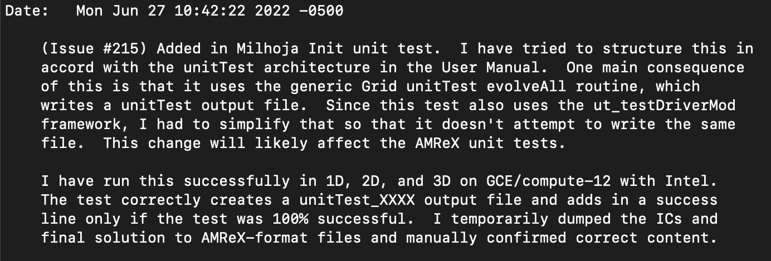
Git lab notes stream
Keep lab notes for your software as close to the “instrument” as possible
Details not obvious from commit diff:
Motivation, reasoning, consequences
Testing notes
*This message is missing a title as the first line.
Use Pull Request to capture final verification streams

Slide 49
Pull request as a “filtered” notebook entry
A pull request is an aggregation of commits to a git repo
Individual commits are linked to the pull request
The PR allows for additional content that’s distinct from the individual commits
Use PR description to record process to verify correctness of changes
2-2.5 days effort carried out over a week
Copy/pasted from previous PR and adapted first (designed process)
Improved as carried out process – converging on a quasi-procedure
Filtered so that reviewers aren’t overwhelmed
Helped organize effort & design good tests
Additional benefits
Senior reviewers provide feedback & suggest improvements
Junior reviewers exposed to work habits of other people
Example: Flash-X PR #247 on next slide

Slide 50
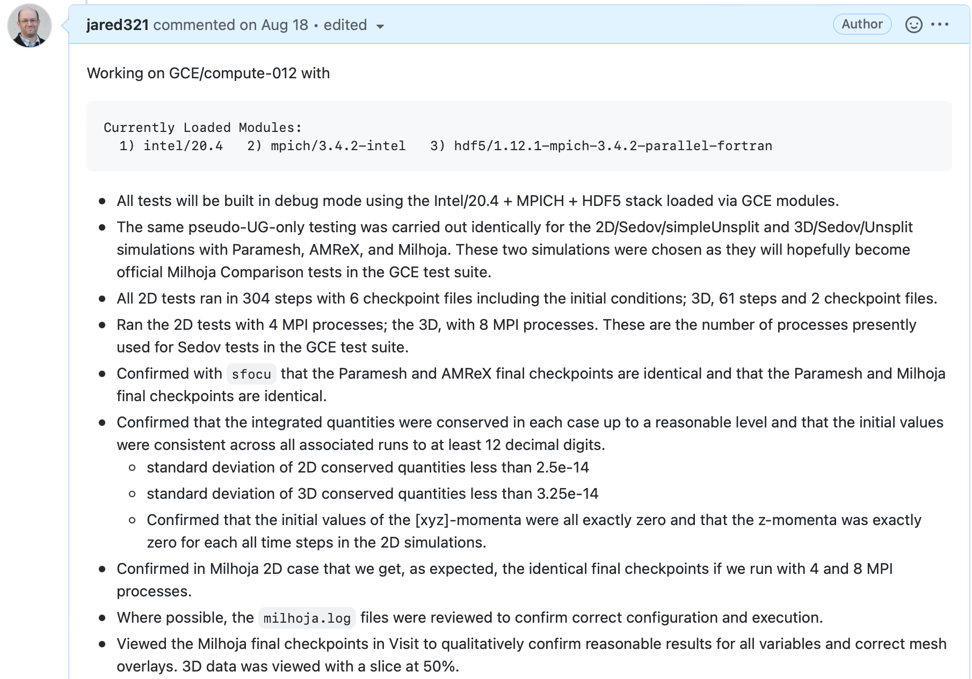
Example: Flash-X
PR #247

Slide 51
README lab notes streams
High-level road maps with motivation, documented decisions, and conclusions
Concise living docs that function as executive summaries
Higher up in documentation hierarchy
Low-level notes such as managing software stack
Traceability of SW environment & therefore verification
Can be turned into procedures

Slide 52
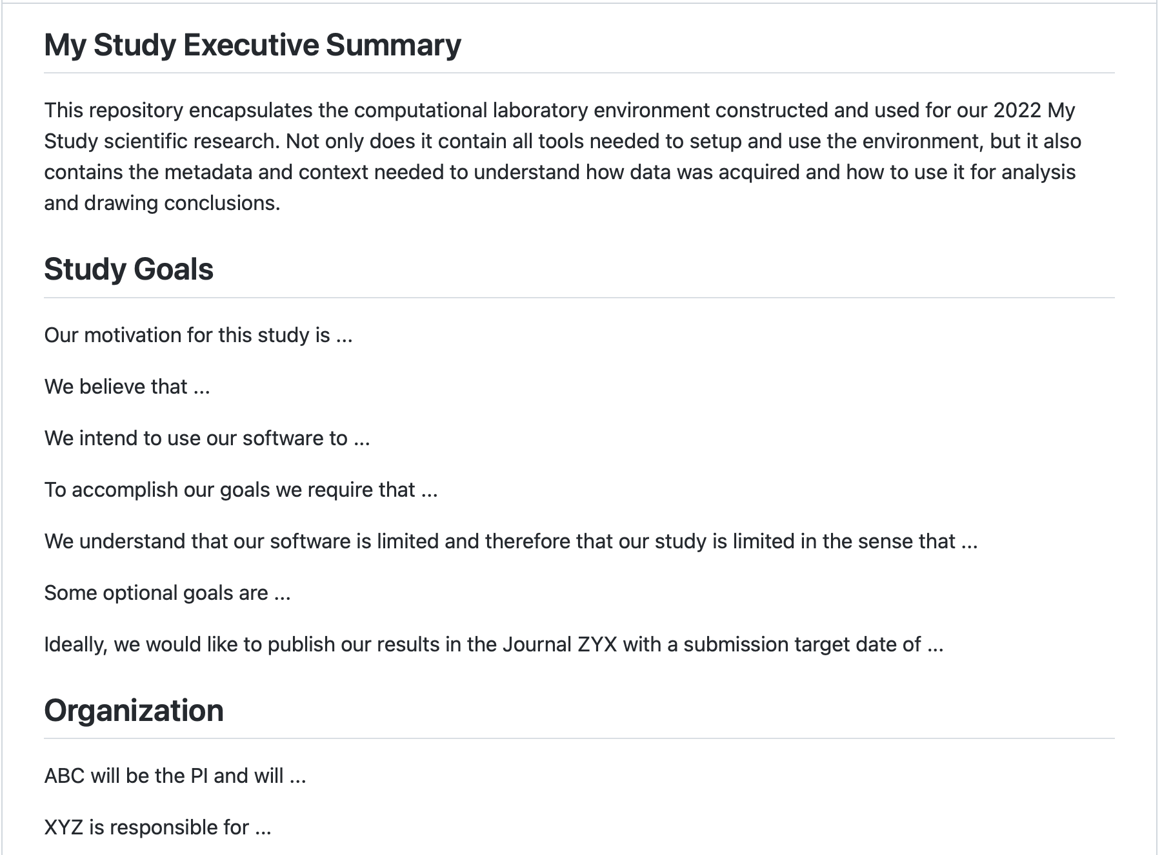
High-level README

Slide 53
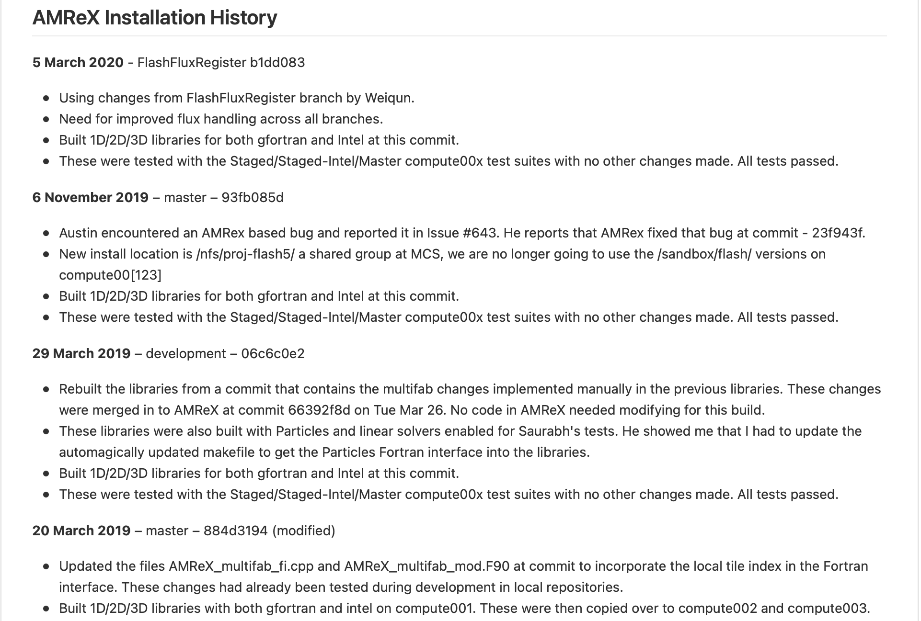
Low-level README

Slide 54
Capturing data context & metadata
Automate as much as possible
Build dates, user, system name, git hashes, configuration data in file headers
Self-documenting files
Build & job logs
Software environment info (e.g., modules, ldd output)
git diffs
Environment variables

Slide 55
Jupyter notebooks
The exception to the rule?
Jupyter notebook can put context & metadata next to data
High-level design & motivation up top
Low-level lab notes for acquiring data
Load & use data
Generate visualizations in place
Comment on results
Where do notebooks fit into the documentation hierarchy?
Repetitive use of notebook?
Limit amount of code in notebook

Slide 56
How to organize your “virtual” (multi-stream) lab notebook?
It should be
Easy to create and maintain lab notes
Easy to concentrate more on executing work & less on documenting it
Easy to find what you need
Each stream should
Have a clear identity for what it records
Not contain notes contained in other streams
Be recorded by using the right tool for the job
This implies the need for a documentation scheme.
Consider: design your lab notebooks into a larger execution environment.

Slide 57
Strategies for Improving Reproducibility With lab notebooks
Be thorough in capturing provenance
Agents (codes), entities (inputs, outputs, etc.), activities (the transformation)
Capture code version
Capture all inputs/configuration information for each experiment
Use multiple systems to ensure that you can correctly associate inputs, outputs, and code versions
Systematic directory and file naming conventions
Separate written notes (paper notebook, electronic notebook)
Lab notebooks aren’t just for people who literally work in a laboratory!
Scripts to orchestrate experiments (versioned and captured)
Version control (if data is not too large)
Capture important outputs (as feasible)

Slide 58
Strategies for Improving Reproducibility After Experiments
Continue provenance capture through data analysis/reduction process
Agents (codes), entities (inputs, outputs, etc.), activities (the transformation)
Script as much of your analysis/reduction as possible
Prefer scriptable tools over those requiring human interaction
Keep them under version control
Document your process thoroughly
Separately from scripts, etc.
E.g., paper or electronic notebook
Especially where human interaction is required
Capture key intermediates in the reduction process
The more you capture, the more you will have for verification (and to find problems) later
Capture the data (in machine-readable form) used to produce graphs and tables
Expected by basic data management plans
And an increasing number of publishers

Slide 59
From the Earlier Example
Lab notebook artifacts
every run registers all configurations and runtime parameters in a logfile.
logfiles are cumulative
dedicate space for storing all results in a preconfigured directory structure
scripts to move output from scratch to the dedicated space

Slide 60
Tools May Help with Reproducibility
Just a small sampling…
Containers to capture the software
Resources for finding, understanding, and debugging floating point math problems: http://fpanalysistools.org/
Cloud platforms to publish and reproduce research code and data
E.g., https://CodeOcean.com
DOIs and hosting of data, code, documents, etc.
E.g., https://zenodo.org/, https://FigShare.com
Make sure to test and understand your tools thoroughly before using them for something important!

Slide 61
Resources
A Sampling of Execution Environments
References from slides
ATPESC 2022 Laboratory Environment BSSw Tutorial – Example Repo
Lab Notebooks for Computational Mathematics, Sciences & Engineering, Best Practices for HPC Software Developers webinar series, December 2022
Popper – 2018 BSSw Fellow Ivo Jimenez
FlashKit – Aaron Lentner (George Washington University)
Code Ocean
Weight & Biases (machine learning)
Howard M. Kanare, Writing the Laboratory Notebook. American Chemical Society, Washington, D.C., 1985.
Carlo Graziani, HPC and the Lab Manager. Better Scientific Software. https://bssw.io/blog_posts/hpc-and-the-lab-manager. Nov 17, 2021.
Katherine Riley, What All Codes Should Do: Best Practices. ATPESC 2019 presentation. Retrieved from YouTube. Nov 5, 2019.
DIKW pyramid. 2022, August 4. In Wikipedia. https://en.wikipedia.org/wiki/DIKW_pyramid.
Roberta Kwok, How to pick an electronic laboratory notebook. Nature 560, pp. 269-270, Aug 6, 2018.

Slide 62
Summary
The credibility of your science derives from the credibility of your code (and process)
Science stakeholders are ratcheting up expectations for reproducibility
There are strategies to improve reproducibility in all phases of the scientific process
During development
After development
During experiments
After experiments
They amount to better software development practices
The same kinds of practices advocated for reasons of productivity, sustainability, maintainability, etc.
Machines are expensive to build and expensive to run
They provide opportunity for great work
Care is needed to ensure that the outcome meets expectations
Reproducible results are a necessity, not a luxury
There is no credible science without provenance
"a parameter combination that induces erroneous results is easily selected“ - https://doi.org/10.1063/1.476021

Slide 63
Other resources
The FAIR Guiding Principles for Scientific Data Management and Stewardship. Mark D. Wilkinson, et al. https://doi.org/10.1038/sdata.2016.18
FAIR for Research Software (FAIR4RS) Working Group: https://www.rd-alliance.org/groups/fair-for-research-software-fair4rs-wg/forum/
Editorial: ACM TOMS Replicated Computational Results Initiative. Michael A. Heroux. 2015. ACM Trans. Math. Softw. 41, 3, Article 13 (June 2015), 5 pages. DOI: http://dx.doi.org/10.1145/2743015
Enhancing Reproducibility for Computational Methods. Victoria Stodden, Marcia McNutt, David H. Bailey, Ewa Deelman, Yolanda Gil, Brooks Hanson, Michael A. Heroux, John P.A. Ioannidis, Michela Taufer Science (09 Dec 2016), pp. 1240-1241. DOI: 10.1126/science.aah6168
Simple experiments in reproducibility and technical trust by Mike Heroux and students (work in progress), https://betterscientificsoftware.github.io/Trust-Tools/
What every scientist should know about floating-point arithmetic. David Goldberg. https://doi.org/10.1145/103162.103163

